Slide 1
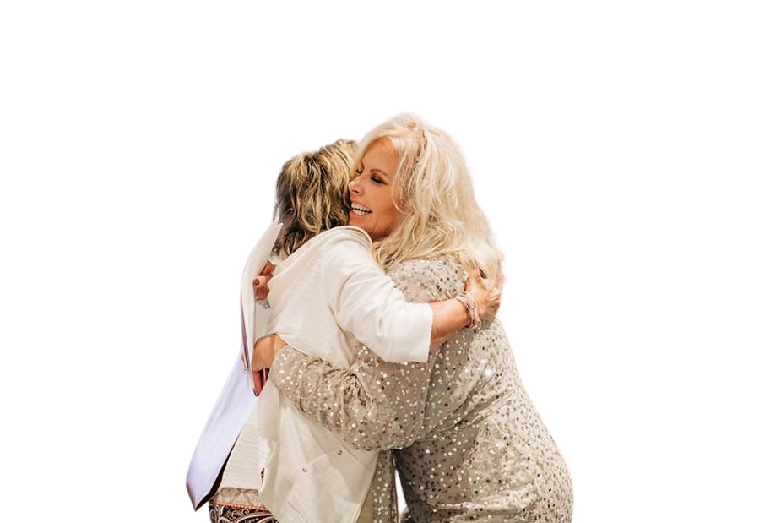

PERMISSION
TO SUCCEED
Presented by Cyndi Garza,
Owner and CEO of Mortgage Girlfriends

Slide 2



MORTGAGE GIRLFRIENDS
  PRODUCT
  SERVICE
  PRICING
  PEOPLE

Slide 3


WHEN THINGS GET TOUGH...
Marketing is the first to go.

Slide 4

MARKETING IS DEEPER
VALUES
Marketing not only promotes a brand, but also reflects its core beliefs and principles.
  Build trust and authenticity
  Build meaningful relationships
  Attract and target your ideal client
  Remain top of mind

Slide 5
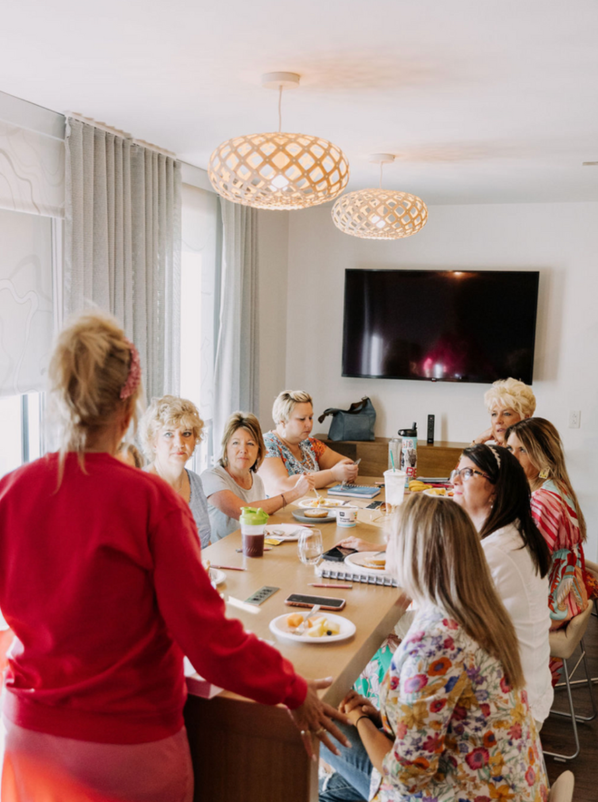

MORTGAGE GIRLFRIENDS
MY VALUES
  Love
  Trust
  Loyalty
  Growth

Slide 6
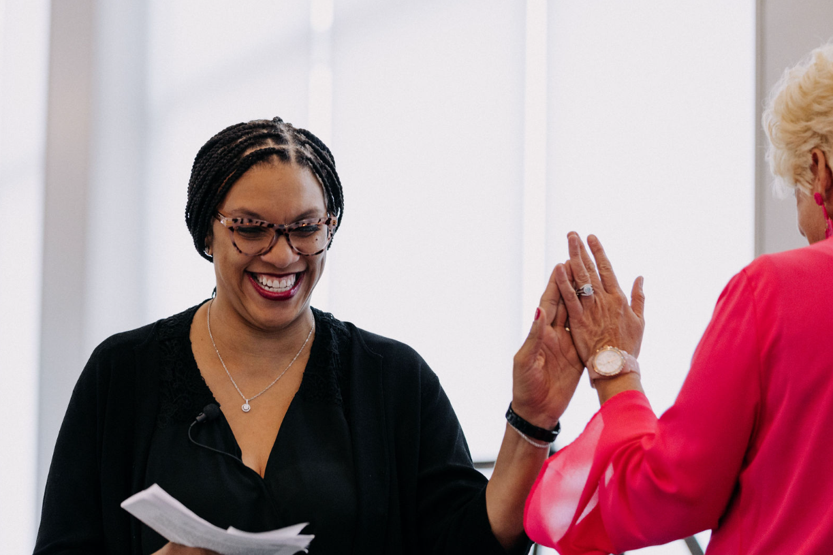
MORTGAGE GIRLFRIENDS
VALUE
  Value- Trust
  Trust Others
  Trust Self

Slide 7

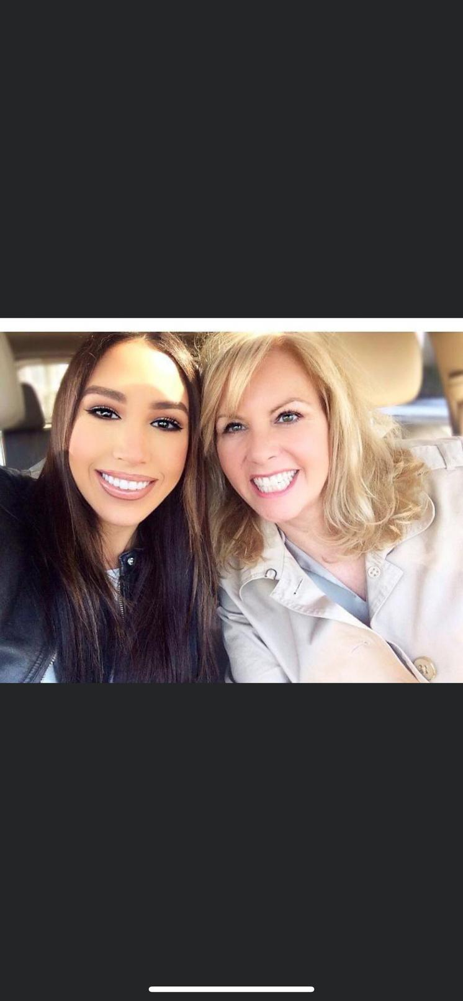
THE CAR RIDE

Slide 8
BEGIN TAKING CARE OF
YOU!

Slide 9
VALUE
GROWTH

Slide 10


Slide 11


Slide 12
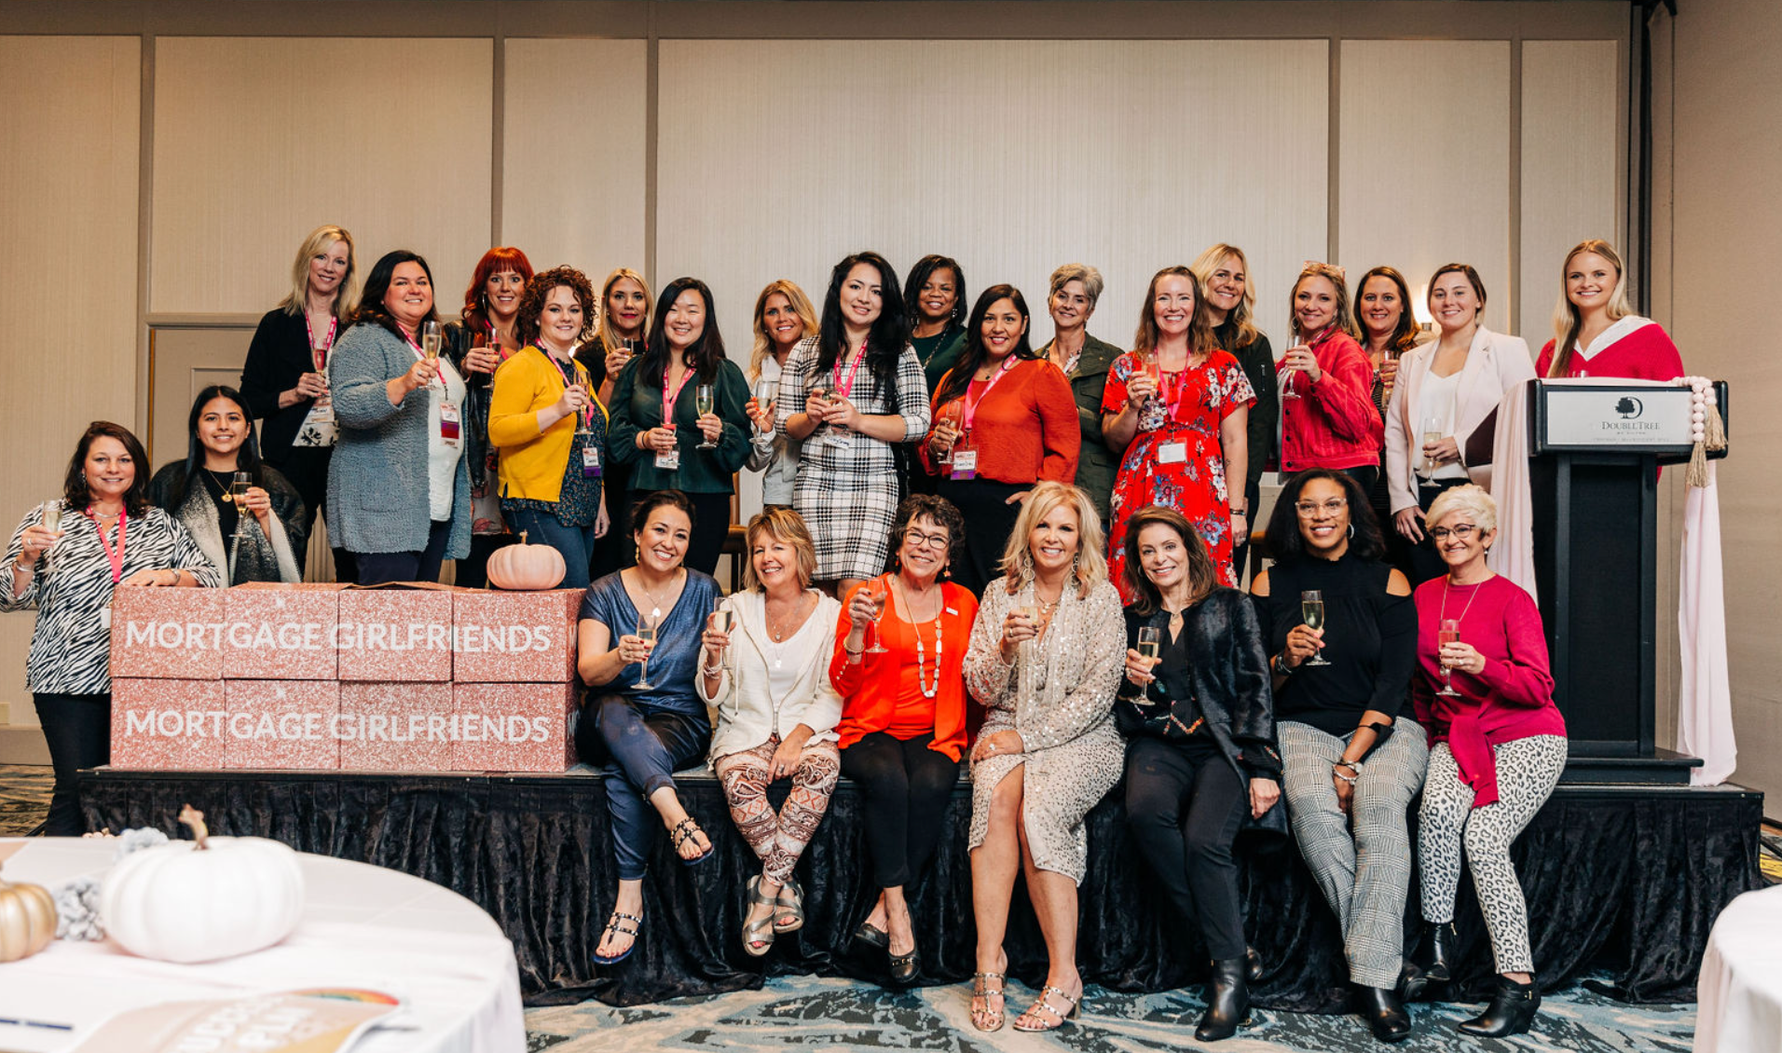

Slide 13
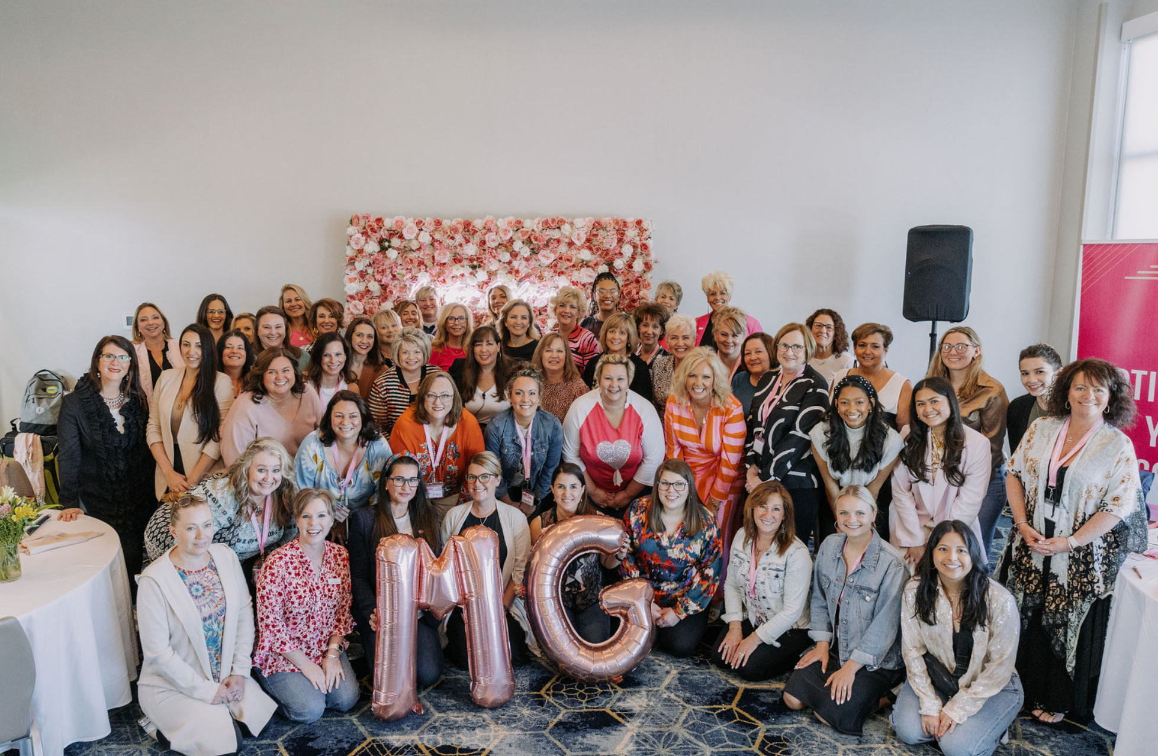

Slide 14
VALUE
LOYALTY

Slide 15
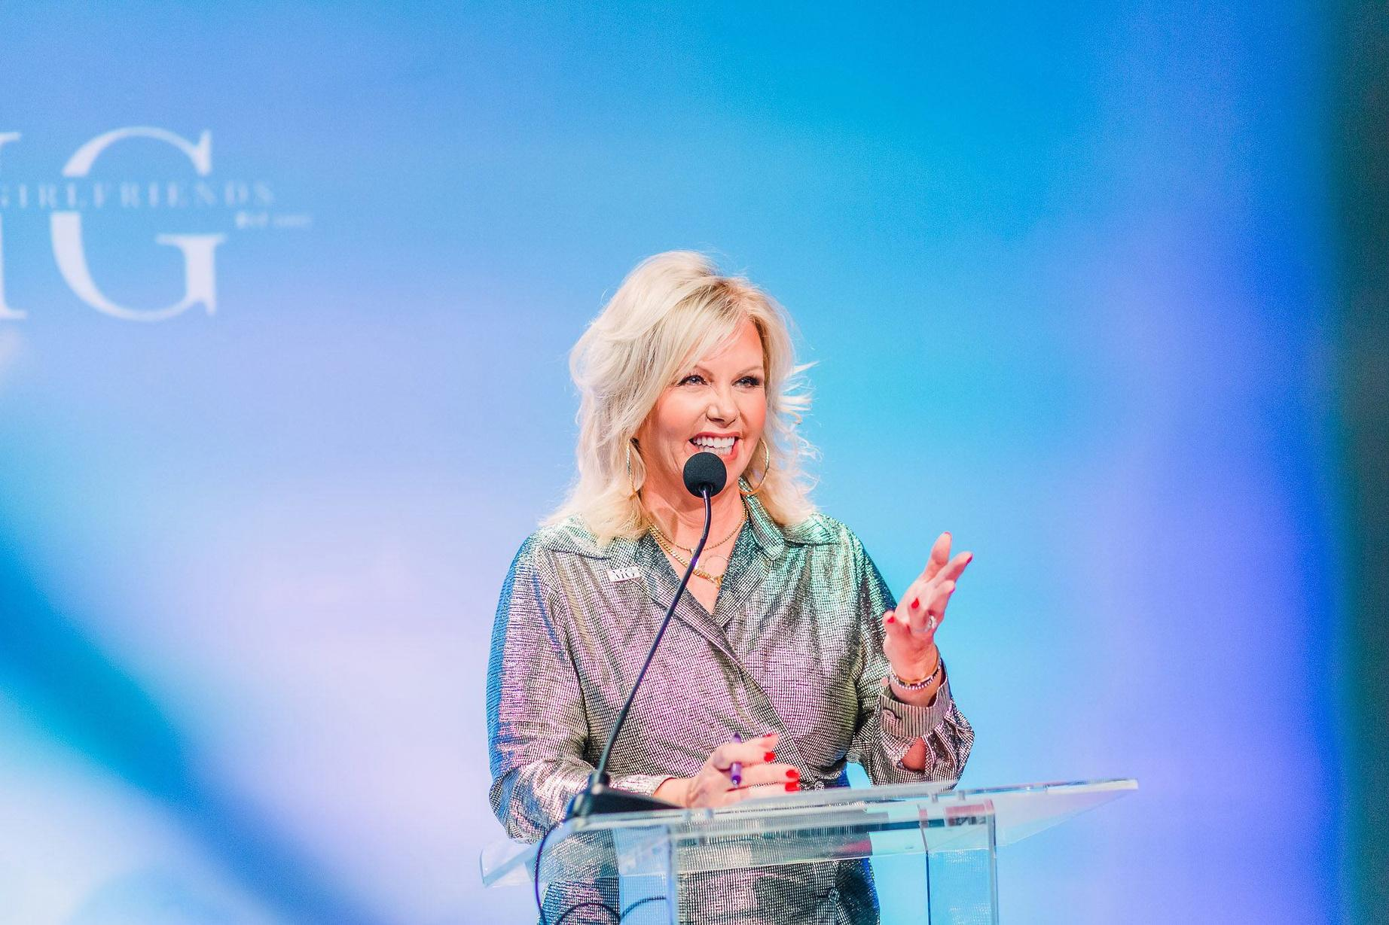
  Loyal Daughter
  Loyal wife
  Loyal mom
  Loyal employer
  Loyal to family
  Loyal to self

Slide 16
VALUE
LOVE

Slide 17

MORTGAGE GIRLFRIENDS
THE OPPOSITE OF LOVE IS FEAR...
  SCARCITY
  ABUNDANCE

Slide 18

LOVE YOURSELF
LOVE OTHERS

Slide 19
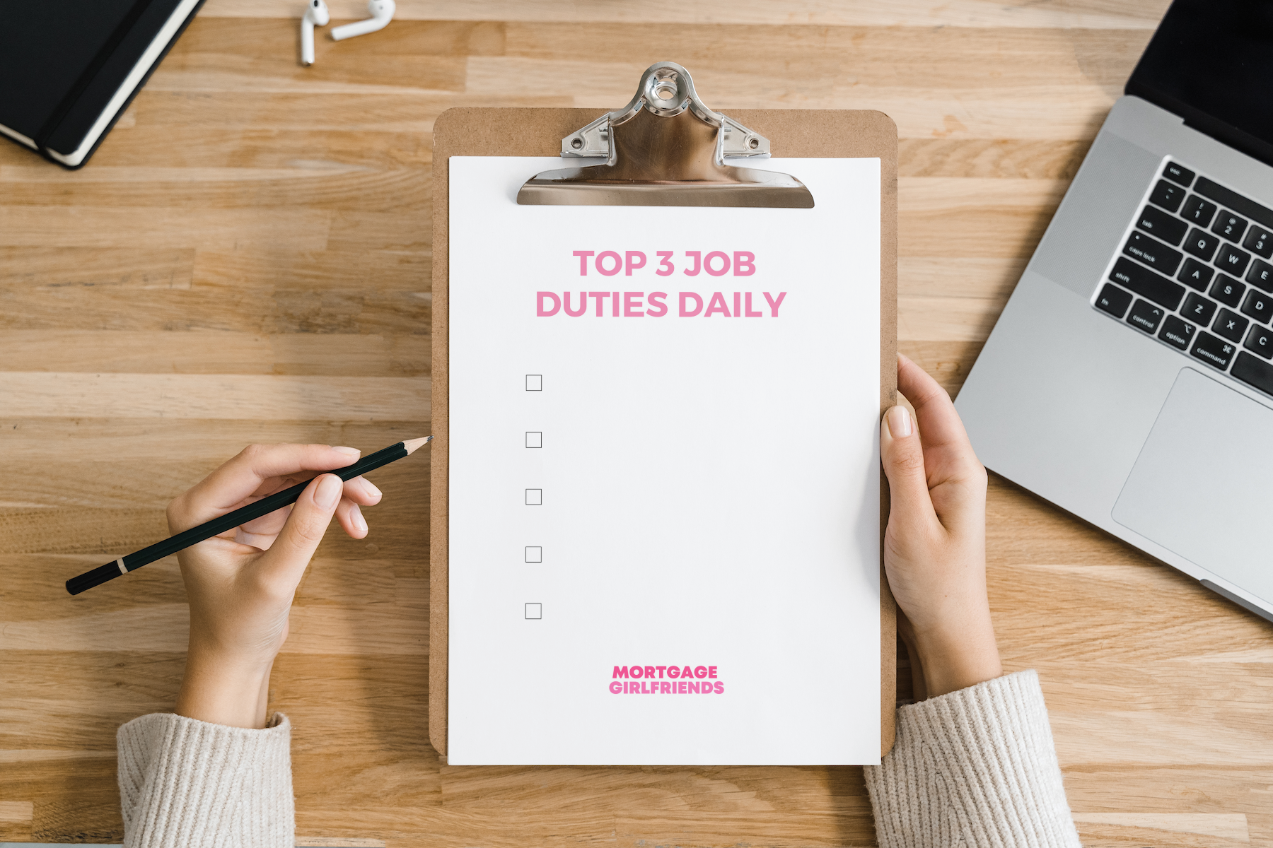

Slide 20
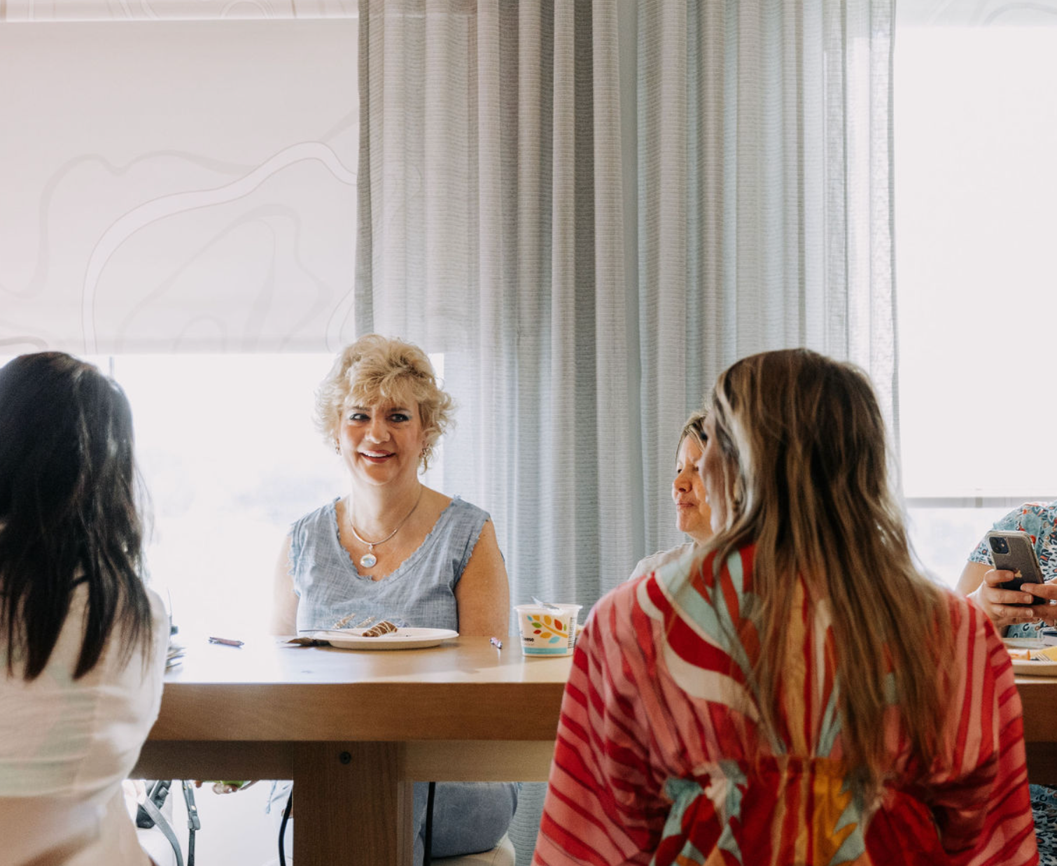
YOU HAVE ONE JOB
BE YOURSELF

Slide 21




Permission
to Succeed
Your Way
and in All
Areas of Life!

Slide 22

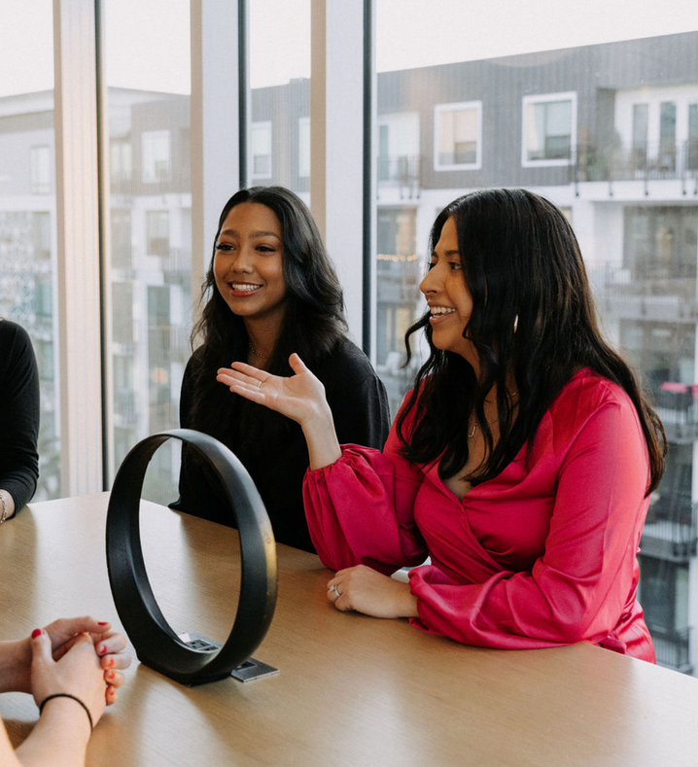
DIGITAL MARKETING AGENCY
At Msurge, we are dedicated to your success. We specialize in developing unique and dynamic strategies tailored to help brands and clients achieve their goals. Our services go beyond strategy creation, as we are committed to fostering growth for businesses of all sizes. We strive for excellence and deliver premium quality work precisely when you need it. With our unwavering dedication, we aim to ensure enduring success and prosperity for our clients.
WHAT WE DO
  Social Media Management and Content Creation
  Personal Branding
  Optimal Social Media Posting & Analytical Reporting
  Direct Interaction & Social Media Monitoring
  Flyer, Brochure, and Presentation Creation
  LinkedIn Database Connection
  Social Media Profile Audit
  Document Recreation/ Refresh
  Website Development and SEO
  Employee advocacy program- get your corporate content out to your employees audiences
www.msurge.com

Slide 23
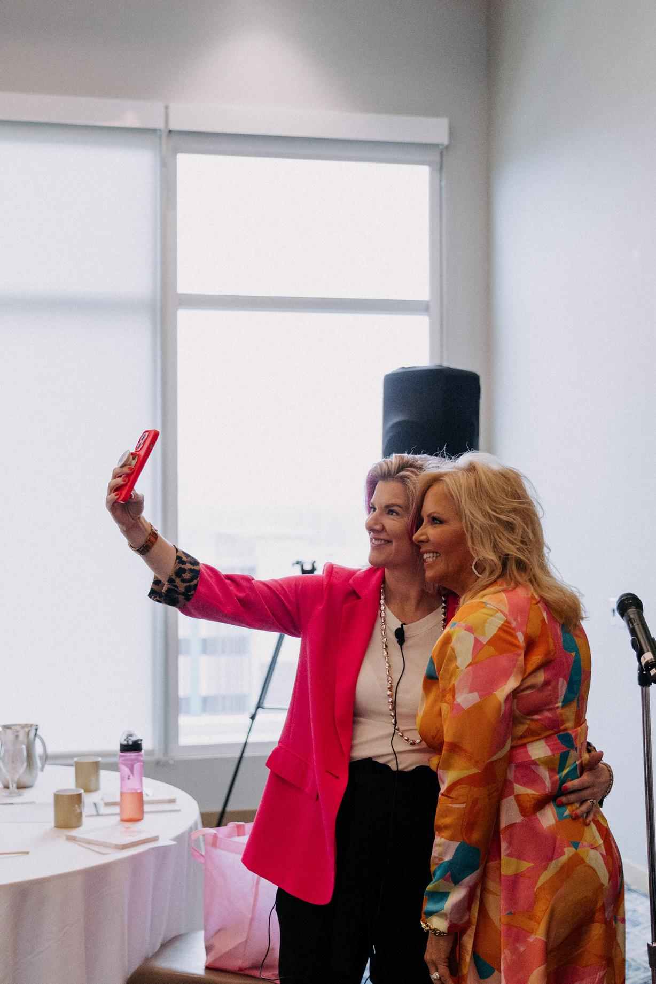
THE MORTGAGE INDUSTRY'S MOST
POWERFUL WOMEN
Mortgage Girlfriends is a community of motivated mortgage professionals that are passionate about achieving success and redefining their industry. Founded in 2007 and led by CEO Cyndi Garza under the ideals of education, empowerment, and acceptance, Mortgage Girlfriends has grown into the most enriching and valuable resource available to female mortgage professionals.
BOLD CONFERENCE 2024
FEBRUARY 1-3, 2024 | TAMPA, FL
Get set to ignite change at the 2024 Mortgage Girlfriends Bold Conference, themed "POW!" - a call to action for audacious women symbolizing Power in all forms: Women, Wealth, Wellness, Winning, and Work.
This event is more than a celebration, it's an opportunity-filled platform to grow your business, pivot in the dynamic market, and adapt to new shifts. We're dedicated to your personal and professional development, promising a transformative experience that will push your boundaries.
Mark your calendars and join us to step into your power, embrace change, and celebrate womanhood at the 2024 Mortgage Girlfriends Bold Conference. Let's create a POWerful impact together!
INTERESTED IN BECOMING A SPONSOR?
Email info@mortgagegirlfriends.com

Slide 24
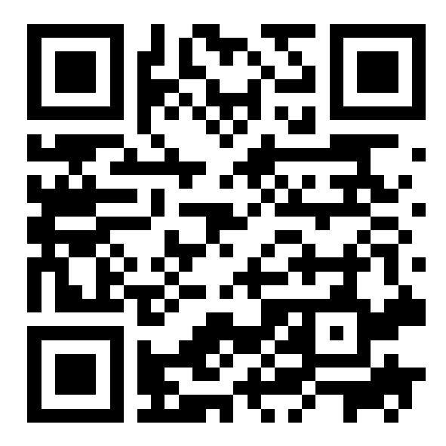
JOIN THE
MORTGAGE GIRLFRIENDS COMMUNITY
Use the code "FREEBOLD22" for a free 30 days when you sign up for a monthly membership!
www.mortgagegirlfriends.com/join

Slide 25

GROW YOUR LIFE & BUSINESS
At Optimized Success, we empower our clients with the tools and resources they need to succeed in any industry. Our mission is to provide our clients with the education and support they need to reach their goals. We believe that success comes from within, and we are dedicated to helping our clients find it. We believe that success is attainable for anyone who commits themselves to growth and learning.
GROUP COACHING
1-1 COACHING
LEADERSHIP TRAINING
SPEAKING EVENTS
“The single biggest way to impact an organization is to focus on Leadership Development”
www.oscoaching.org
– John C. Maxwell

Slide 26
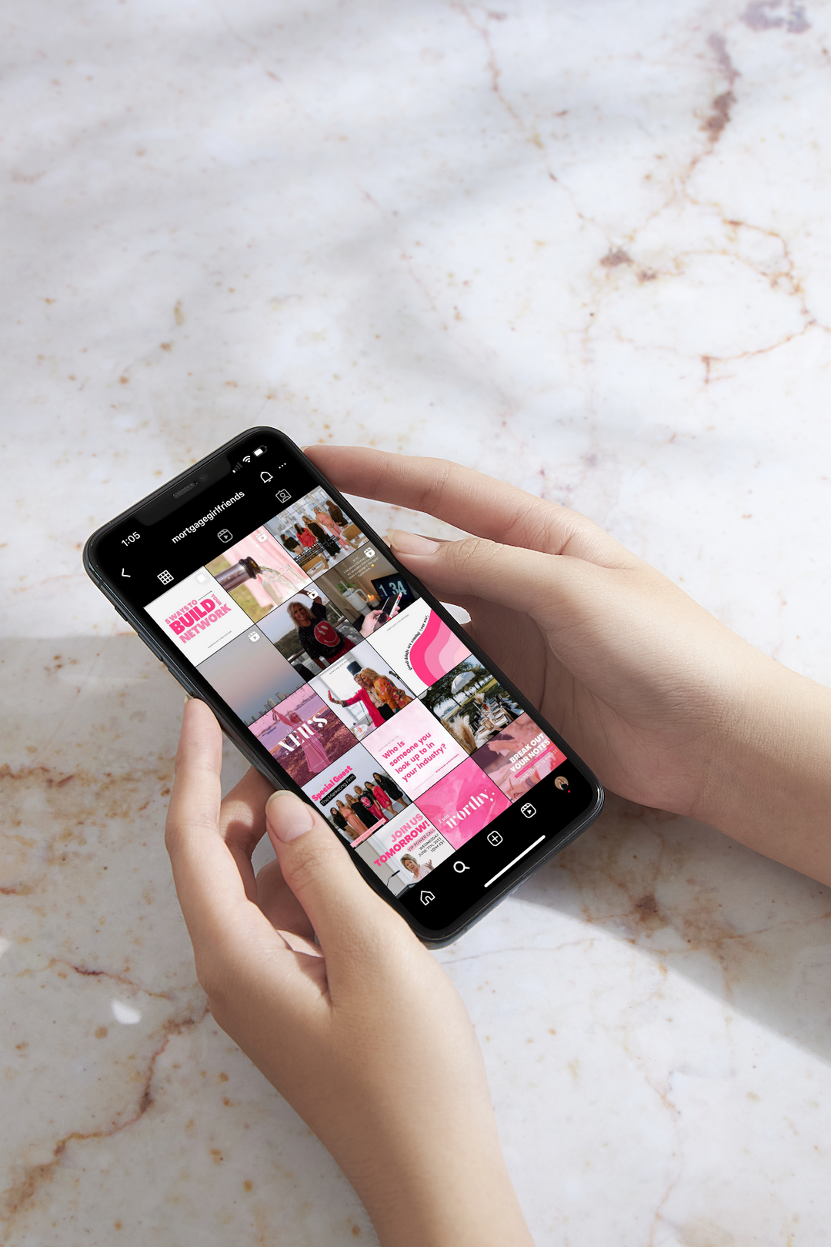



FOLLOW US ON SOCIAL 🤳
www.mortgagegirlfriends.com
@mortgagegirlfriends
Mortgage Girlfriends
@mortgagegirlfriends

