Slide 1
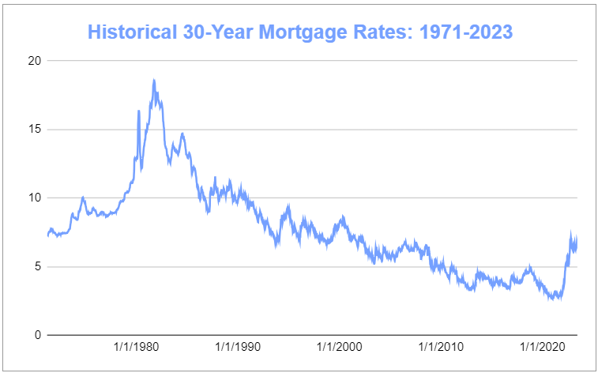

Slide 2
Mortgage Origination Dollar Volume to Decline 22% in 2023
Source: MBA Forecast

Slide 3
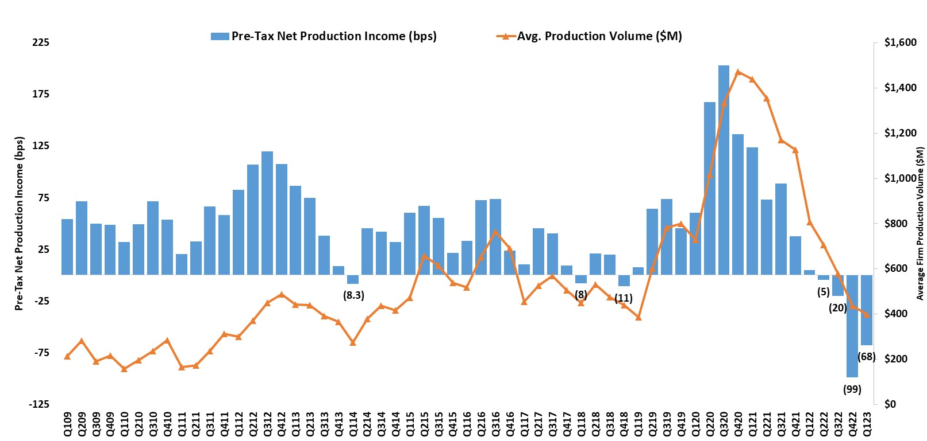
Pre-Tax Net Production Income for IMBs at a Loss for Fourth Consecutive Quarter; Improvement Over Q4 2022
Quarterly Average (Q308-Q123):
48 basis points or $1,092 per loan
Source: MBA Quarterly Mortgage Bankers Performance Report: www.mba.org/performancereport
3

Slide 4
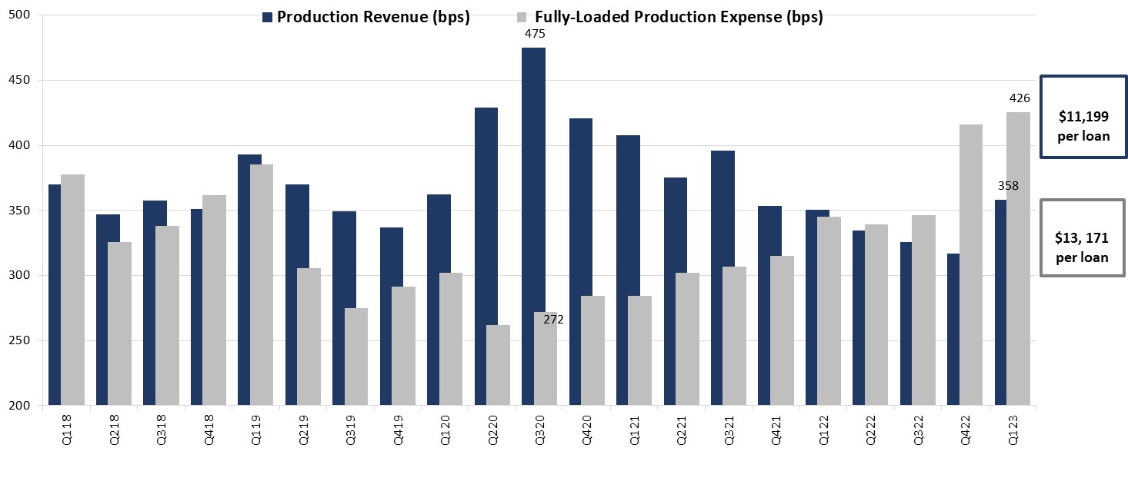
Production Revenues Up; But Expenses Up Too in Q1 2023
Source: MBA Quarterly Mortgage Bankers Performance Report: www.mba.org/performancereport
4

Slide 5
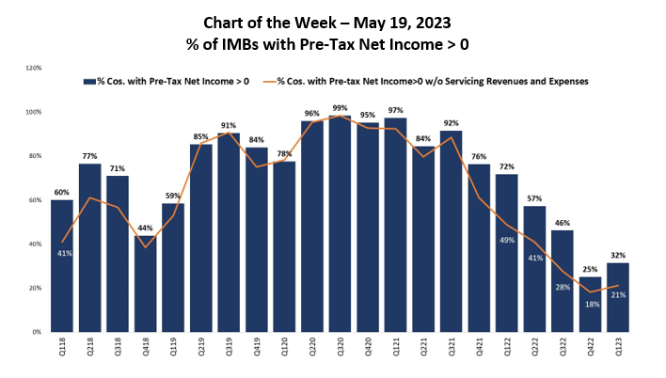
About 1 in 3 Mortgages Companies Posting Overall Profits (Production and Servicing Business Lines Combined); Servicing Helped in 2022
Source: MBA Quarterly Performance Report; www.mba.org/performancereport
5

Slide 6
Mortgage-Treasury Spread Still Wide
Source: MBA, US Treasury

Slide 7

2023 Homeownership Initiative
Goal: To give 10,000 books to students and their families between now and October’s Annual Meeting.
Your child will enjoy the Adventures of Princess Mackie and her mother as they navigate their home-buying journey. Through this story, children will gain a better understanding of the path to homeownership, and also learn valuable lessons about other financial concepts such as generational wealth-building, saving money, budgeting, and goal setting. It is important to plant seeds of home ownership and financial literacy early and often so that children can understand this as a true possibility for them in the future.

