Slide 1

The Future of Finance for Women:
Research on NextGen Women & How to Win their Business
AUGUST 2023
By Kristin Messerli, market researcher & executive director of FirstHome IQ
Sponsored by National MI, Presented to Michigan Mortgage Lenders Association
Kristin Messerli |
KristinMesserli.com | NextGenHomebuyer.com | FirstHomeIQ.com

Slide 2
1
Empowered women today
TODAY’S JOURNEY
2
The not-so-empowered women
2
The future of empowered women

Slide 3
Empowered women
SECTION 1

Slide 4

Women’s Wealth & Power in the U.S.
Education: Female vs. male heads of household are equally educated today, and that education correlates with higher rates of homeownership (Urban Institute)
Purchasing Power: Women control a third of US household financial assets. (McKinsey)
Head of Household: Among married households, the share of women heads of household increased 24.3 percentage points, from 21.8 percent in 1990 to 46.1 percent in 2019. (Urban Institute)
Decision-Making: There has been a 30% increase over the past 5 years in married women making financial decisions. (McKinsey)

Slide 5

Single Women Homebuyers
Buying More Homes: Single women are the second largest cohort of home buyers in the market today, double that of single men (19% vs 9%). (NAR)
Increasingly Head of Household: From 1990 to 2019, the share of households headed by single women increased from 17.6 percent to 22.6 percent (Urban Institute)
Not Waiting for Marriage: 2 in 3 single women (65%) reported that they would rather not wait until they were married to buy homes, regardless of how old they were. (Bank of America)
Kristin Messerli |

Slide 6
The not-so-empowered woman
SECTION 2

Slide 7


3 E’s of yesterday’s Customer Empowerment
experts
establishment
economy
Kristin Messerli |

Slide 8
1
DISTRUST IN THE
Economy
Job stability and financial anxiety were ranked as top five challenges for women in 2022, significantly more than men.
Kristin Messerli |
Source: 2022 NextGen Homebuyer Report, NextGenHomebuyer.com

Slide 9



NextGen Women
Job Stability
WOMEN
MEN
55%
45%
Millennial and Gen Z reported job stability as a major challenge to their financial situation in 2022, and a barrier to homeownership in 2023.
Kristin Messerli |

Slide 10

FINANCIAL ANXIETY
NextGen women are more stressed about their finances than men
37%
29%
vs
women
men
NextGen Homebuyer Report, Oct 2022, n=1,000
NextGen women are disproportionately impacted by job instability, COVID-19 outcomes, unpaid child and elder care, and other factors outlined in this and past reports.
Kristin Messerli |

Slide 11
Institutional trust is at an all-time low in the U.S.
The U.S. Trust Index dropped below 50% for the first time in
history, declining 10 points since 2017.
2
DISTRUST IN THE
Establishment
of borrowers said reviews are important when it comes to finding a loan officer.
Kristin Messerli |
Source: 2022 Edelman Trust Barometer

Slide 12



NextGen Women and Distrust in
The Housing Market
Women reported higher levels of distrust in the housing market and professionals, which may contribute to the lower concern for market returns on real estate.
However, women have good reason to expect lower returns. According to a recent Yale study, single women are buying homes for an average of 2% more and selling for 2% less than single men. When accounting for the mortgage, men earn an average of 6% more in annual returns (Forbes).
36%
of NextGen women state they agree that the housing market will remain stable over the next five years (vs 43% of men)
79%
of NextGen women homeowners believed their home would be a good investment (86% of men)

Slide 13

Trust has been
lost across institutions
Media & Journalism
Technology
Government
Religion
Healthcare
Education
Nonprofits & Social Services
Kristin Messerli |

Slide 14
2 in 3 NextGen homebuyers said they did not think lenders were trustworthy or reliable and the majority of women didn’t have anyone they trusted to help them make smart decisions about their finances.
3
DISTRUST IN THE
Experts
of borrowers said reviews are important when it comes to finding a loan officer.
Kristin Messerli |
Source: 2021, 2022 NextGen Homebuyer Report, NextGenHomebuyer.com

Slide 15



NextGen Women
Trust in Advisors
“I trust my professional to help me make smart decisions.”
Men
Women
79%
80%
+17
75%
+5
+7
68%
62%
61%
Loan Officer
Real Estate Agent
Bank or Credit Union
NextGen Homebuyer Report, Oct 2022, n=1,000
Kristin Messerli |

Slide 16
NextGen Women
Advice & Support
“I have the professional financial advice and support I need to achieve my financial goals.”
65%
47%
Men
Women
NextGen Homebuyer Report, Oct 2020, n=1,000
Kristin Messerli |

Slide 17

CUSTOMER EXPERIENCE
NextGen women were less satisfied overall with homebuying experience
Number of respondents who rated their home purchasing experience with 5/5 stars
67%
50%
Men
Women
NextGen Homebuyer Report, Oct 2022, n=1,000
Kristin Messerli |

Slide 18
Women have less trust in traditionally empowering experiences
experts
establishment
and have less confidence in their personal financial knowledge
economy

Slide 19
NextGen Women
Early Education
Financial education is a better predictor of homeownership than parents’ household incomes.
Recent homebuyers (72%) were significantly more likely than future homebuyers (62%) to grow up learning how to make a budget or financial plan.
Latinx were most confident in the stability of the housing market, reporting 15% higher confidence than other racial or ethnic segments.
Upper income were 75% more likely to report confidence than low-to-moderate income (53% vs 30%).
“Did you grow up learning how to budget and make a financial plan?”
75%
60%
Men
Women
When controlling for early financial education, many of the gender gaps in our research (i.e. investments, savings) were significantly decreased.
NextGen Homebuyer Report, Oct 2020, n=1,000
Kristin Messerli |

Slide 20
NextGen Women
Investments
In 2020, men were over three times more likely to be investing than women.
This mindset carries to their home buying perspective. Men are three times more likely to utilize their home as an income property like renting it out on Airbnb or finding roommates.
In 2023, women were significantly less likely to prioritize a return on investment when buying a home in comparison to men (51% vs. 71%).
Latinx were most confident in the stability of the housing market, reporting 15% higher confidence than other racial or ethnic segments.
Upper income were 75% more likely to report confidence than low-to-moderate income (53% vs 30%).
Men
Women
Investing in the stock market and other non-retirement
67%
39%
Prioritize resale value when home shopping
72%
51%
NextGen women are less likely to invest in non-retirement investments.
Kristin Messerli |

Slide 21

NextGen women are less confident in where to begin the home buying process
“I don't know where to start the process of buying a home.”
“I think in the past,
there hasn’t been a lot
of transparency
about the process
and there’s just so
many steps that are
really intimidating.
Reina, 31
40%
30%
vs
women
men
NextGen Homebuyer Report, Oct 2023, n=250
In 2020 and 2023, NextGen women reported their uncertainty about the process as a major barrier to homeownership.
Kristin Messerli |

Slide 22
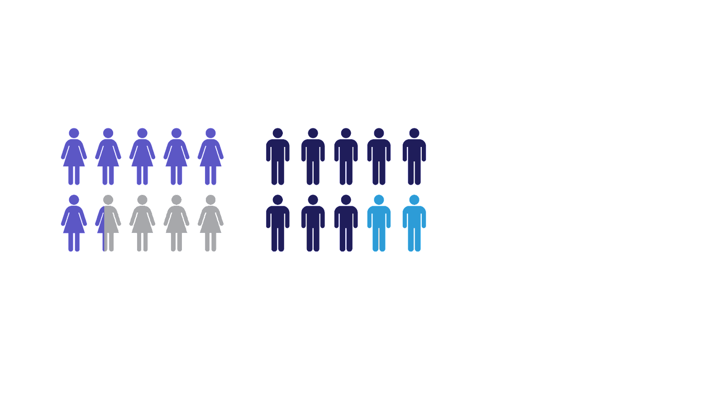
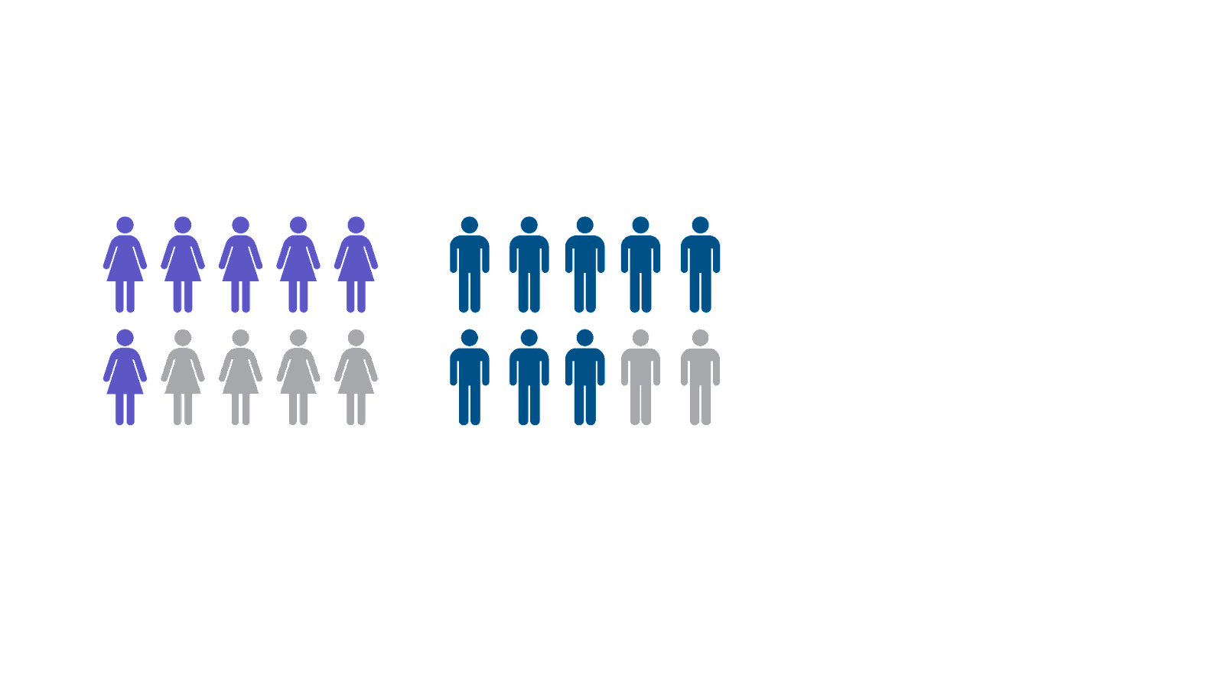
NextGen Women
Financial Knowledge
NextGen women were more likely to report a lack of confidence in where to begin the home buying process as compared with men.
Women reported a fear of being taken advantage of as a primary reason for not turning to a financial advisor (2020), and only 47% said they have the financial advice and support they need to achieve their goals (2022).
Confidence in knowledge of personal finance
58%
69%
of women say they are confident in their knowledge about personal finance
of men say they are confident in their knowledge about personal finance
NextGen Homebuyer Report, Oct 2022, n=1,000
Kristin Messerli |

Slide 23
Winning business by empowering women
SECTION 3

Slide 24

Our actions are inextricably tied to our thoughts, emotions, and experiences
Kristin Messerli |

Slide 25



Financial Outcomes =
+
+
feelings
thoughts
behavior
Kristin Messerli |

Slide 26

customer
empowerment
3.0
doing (engagement)
thinking (education)
feeling (empathy)
Kristin Messerli |

Slide 27
empathy
HOW DO THEY FEEL?
How do consumers feel before, during, and after the homebuying process?
How do they feel about money, home, and community?
Kristin Messerli |

Slide 28
education
WHAT DO THEY THINK?
What do consumers know and what do they want to know about buying a home?
What are their biggest concerns?
What resources or information would be helpful for them?
Kristin Messerli |
Notes:
Show up and engage with your customers, your partners, and your community

Slide 29

Top Homebuying Challenges
for nextgen women
High home prices
73%
Need for job stability
72%
Insufficient down payment
72%
Low credit score
60%
“What is currently preventing you from buying a home?” (Jan 2023)
Finding the right home
51%
Buyer competition
47%
Uncertainty in where to start
40%
NextGen Homebuyer Report, Jan 2023, n=250
Women agreed more frequently than men that not knowing “where to start the process” was preventing them from purchasing a home (40% vs. 30%).
Kristin Messerli |

Slide 30

Home Preferences
Women vs Men
HOME FEATURES
WOMEN MEN
Safety of the home / neighborhood
86% 86%
Living in a good school district
73% 78%
Home design features
65% 70%
“When shopping for a home, what do you prioritize?” (Jan, 2023)
Men agreed nearly 20% higher percentage points than women that a return on investment is a priority when shopping for a home.
Energy efficiency / sustainability
62% 71%
Job proximity
62% 67%
Proximity to friends / family
55% 67%
Resale value / ROI
51% 72%
NextGen Homebuyer Report, Jan 2023, n=250
Kristin Messerli |

Slide 31
engagement
WHAT DO THEY DO?
What leaders and influencers do they follow?
Where do they consume information?
What do they want from a consumer experience?
Kristin Messerli |
Notes:
Show up and engage with your customers, your partners, and your community

Slide 32

Top Social Media Platforms
for nextgen women
73%
Instagram
68%
YouTube
68%
Facebook
52%
TikTok
43%
Twitter
43%
Snapchat
Men were more likely to report regular use on YouTube (80%), Facebook (77%), and Twitter (62%), and less likely to use Pinterest (24%).
38%
Pinterest
26%
LinkedIn
NextGen Homebuyer Report, Oct 2022, n=1,000
Kristin Messerli |

Slide 33
customer
empowerment
3.0
engagement
education
empathy
Kristin Messerli |

Slide 34

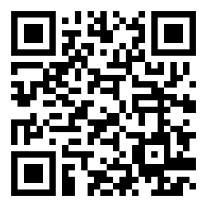
Visit the website for past reports and to sign up for a new Millennial show!
Kristin Messerli |

Slide 35


Slide 36
Young
consumers are born into barriers to
Financial Freedom
Financial Literacy
One-third say they are not confident in their personal knowledge and that it is a current barrier to buying a home.
Trusted Resources
46% report not having access to the trusted advice or support they need to achieve their financial goals.
Demographic Disparities
Over half of Gen Z make up ethnic minorities but make up only 20% of millennial homebuyers.
FIRSTHOMEIQ.COM
Source: 2022 NextGen Homebuyer Report, US Census, NAR 2022

Slide 37

PARTNER WITH FIRSTHOME IQ
To deliver homeownership education, inspiration, and resources to five million young adults before they turn 25.
Financial education should start before major decisions like buying a home, going to college, or getting a job.
FIRSTHOMEIQ.COM

Slide 38
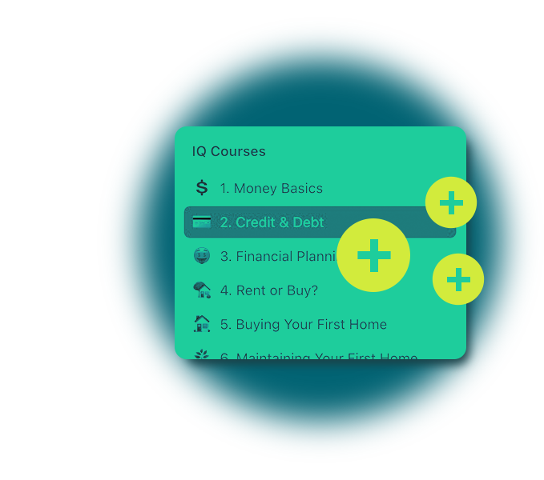


HOW IT WORKS
teachers
professionals
gen z students
Interactive courses covering topics from financial literacy to buying and renting a home.
Course curriculum with presentation materials, handouts, and activities for classroom learning.
On-site presentation materials, Gen Z sales training and research, and volunteer matching.
FIRSTHOMEIQ.COM

Slide 39


HELP US REACH
5 million gen z before 25
improve digital production
enhance live education & outreach
Gamified, AI-powered education and personalization by education level and language preference
Engaging, professional video production & content support team
School and partner implementation team, working on adoption and volunteer coordination
Physical games with discussion to improve classroom experience
FIRSTHOMEIQ.COM

Slide 40
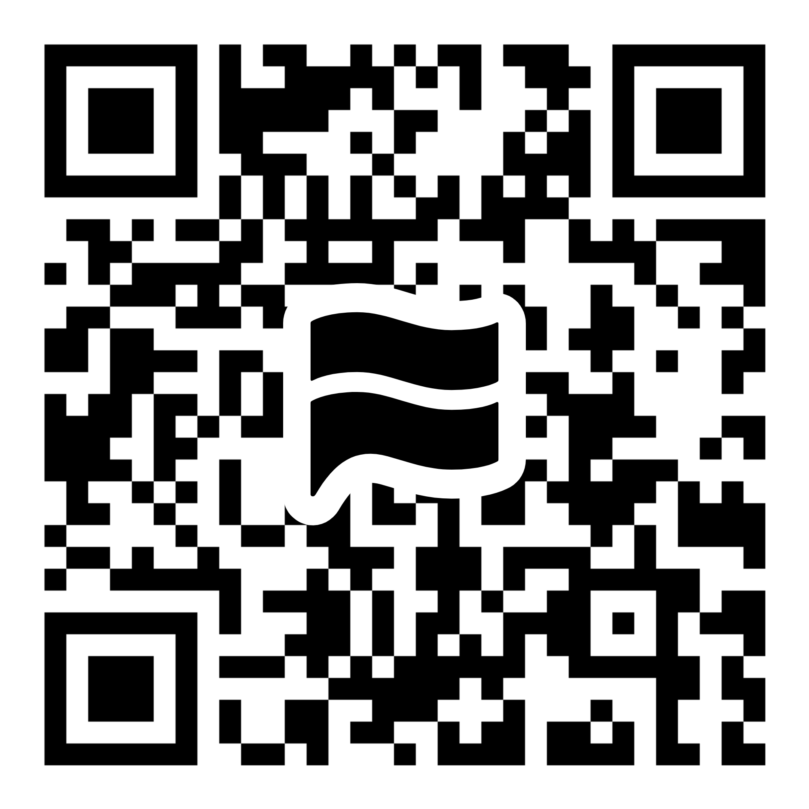
HOW TO GET INVOLVED
Text “join” to 213-277-8356
Join. Get notified of our upcoming launch, or sign up for email updates at firsthomeiq.com.
Donate. Text “donate” or visit our website for more information.
Volunteer. Connect us with your local school or community organization. Text “volunteer” for more information.
FIRSTHOMEIQ.COM

